Slide 1



G H RAISONI INSTITUTE OF ENGINEERING AND TECHNOLOGY, NAGPUR
(Approved by AICTE, New Delhi and Recognized by DTE, Maharashtra)
An Autonomous Institute Affiliated to Rashtrasant Tukadoji Maharaj Nagpur University, Nagpur
Accredited by NAAC with A+ Grade
Department of Computer Science & Engineering
Introductory Seminar
On
ALUMNI MANAGEMENT & INTERACTION
(ALUMNUS)
Name of Projectees :-
Shreya Jethekar
Ishika Chakraborty
Karan Kurani
Paras Shrawney
Chaitanya Thakur
Session 2021-22

Slide 2
Contents
Introduction
Literature Survey
Aim / Objectives
Justifications for Selecting the Title
Block Diagram / Methodology
Software and Hardware Requirements
Expected Result
References

Slide 3
Introduction
PRESENTING YOU -
An ALUMNI MANAGEMENT & INTERACTION system project is
An ULTIMATE Solutions OF All the Alumni Queries.
Maintaining an up-to-date database can be challenging, especially if you do not have a system for regularly updating records. Handling all the records is a difficult task for the user this product provides easy way for maintaining records.
Alumni management platforms centralizes all your data in one place. many user-friendly form controls have been added in order to make it a user interactive application.
This project stores Alumni database which makes it easier to maintain the records of the alumni along with staff details. The proposed system will be on-line so it can be accessed by alumni anywhere.There are many records such as alumni details, course details , etc.
- For Faculty: It helps to manage and maintain Alumni's data / information with
the easy access to records.
- For Students: It allows new and old students of a college to communicate with
each other in a professional manner(through emails).

Slide 4
Introduction
Provides multiple user friendly, experienced functions to the User
i.e. Both Faculty as well as for College student, depending upon there
role in the system (Login type).
Equipped with personal data security.
Provides multiple user friendly, experienced functions to the User
i.e. Both Faculty as well as for College student, depending upon their
role in the system (Login type).
Equipped with personal data security.
The application can be accessed throughout the organization of a specified Department Faculty/ Student user.

Slide 5
Literature Survey
Sr. No. | Paper Title and its Author | Details of Publication | Findings
1 | CAs Based Student-Alumni Management System -IEEE | Published in: 2021 International Conference on Communication, Control and Information Sciences (ICCISc) | https://ieeexplore.ieee.org/document/9485017 various profession choices that are available, wherein a person could choose from and this proposed framework is a predictive system which tries to predict the career option based on the success rate of the students.
2 | Features of Alumni Management System ,Anand Shirke | 01, June 2021 | https://www.iitms.co.in/blog/features-of-alumni-management-software.html bridge that connects alumni with recruiters.
3 | Alumni Management System - intelschool | 6 April,2020 | https://www.intelschool.in/alumni-management-system/ Capture the complete alumni database during the registration process itself
4 | Alumni Management System project- ProjectsGeek | November 21, 2015 | https://projectsgeek.com/2015/11/alumni-management-system-java-project.html a chat feature which will enable alumni to chat without revealing their mobile number or personal e – mail ID.
5 | Alumni Management System - technodog | December 2016 | https://www.technodg.com/alumni-management-system.html Admin option to edit / delete / register new alumni.

Slide 6
Aim / Objectives
AIM :- Developing an ALUMNI MANAGEMENT & INTERACTION
Android Application for the Students And Faculty.
The objective of our project is to notify the students about different Post/designation gained by the students of our previous batches to keep them updated.
To build a system that will be able to manage alumni data of a college and provide easy access to the same.
To reduce manual work.
To provide user-friendly interface.
Quick data retrieval and large amount of data storing .
To provide sorting of data as per the demands.
To allow new students of a college to communicate with each experienced old students. This allows students to know about each other and their current activities by providing Tools/Platform to them.

Slide 7
Justification For Selecting The Title
Nowadays, It is hard to maintain students data , to maintain their track record and specially their current job profile or any other kind of document/information .
As the world had faced the global Covid pandemic crises it became difficult for students to get in touch with the colleges regarding the updates of placement received by the final year student in various fields and gain some useful guidance.
The system has been developed keeping in mind about the changing scenario of the market.
Institution can have regular contacts and updates from the old students.

Slide 8
Block Diagram / Methodology
APPLICATION FLOW :-
Navigation Screen
Search section
Full Details
(Including Contact details)
Login Screen……
Splash Screen......
Signup Screen…..
FACULTY LOGIN
Navigation Screen
Search section
Full Details
(without Contact details)
STUDENT LOGIN

Slide 9
Software and Hardware Requirements
SOFTWARE :- Android Studio, Java JDK.
HARDWARES:- Computer / Laptop, Android Phone, USB Devices or Emulator
FRONT-END :- XML , Adobe Xd
BACK-END :- Java
DATABASE :- Firebase(for database)
SYSTEM REQUIREMENTS :- 8Gb RAM or more, 2nd generation Intel Core or Newer.
OPERATING SYSTEM :- Windows 10 or Newer.
ANDROID REQUIRMENT :- Android Operating System
Android Minimum Version: Android 4.4(KitKat)

Slide 10
Work done till date
Creation of google form for final year students
Ui/Ux Prototype is Ready
App Module Level 1 is Ready
Ongoing work
Implementation of Design into Application.
Implementation of Collected Data to database (Firebase).
Working on app module level 2.
Working on Application Promo .

Slide 11
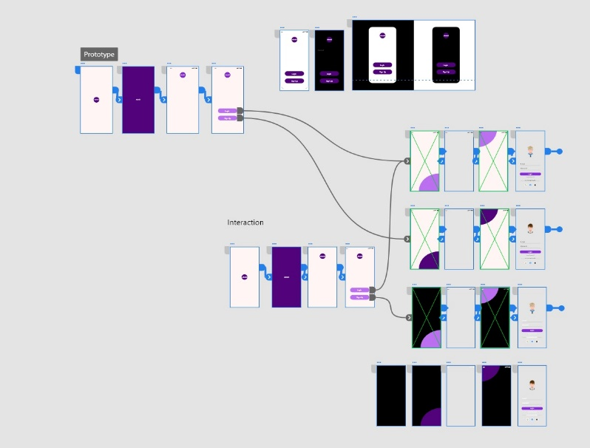
Work done till date

Slide 12

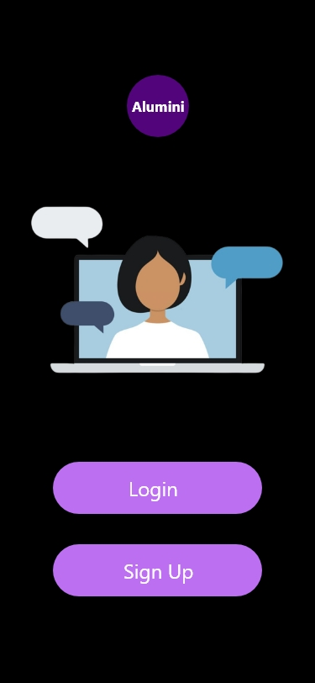
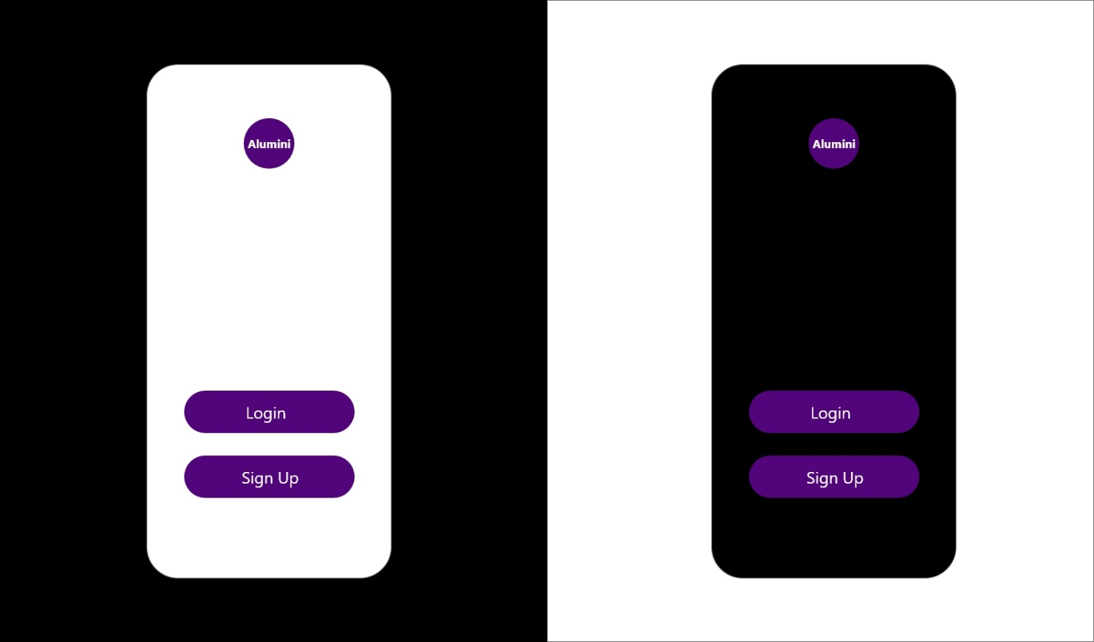
Work done till date

Slide 13

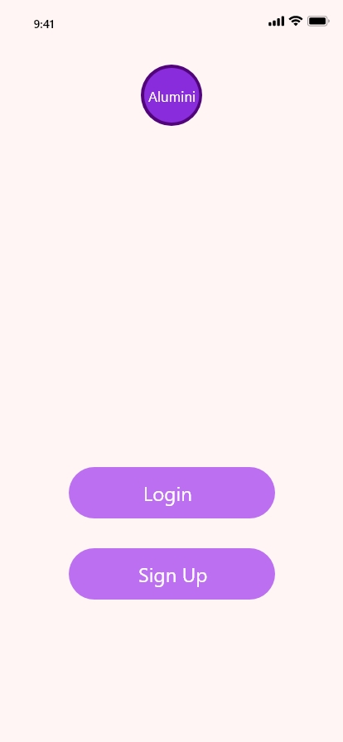
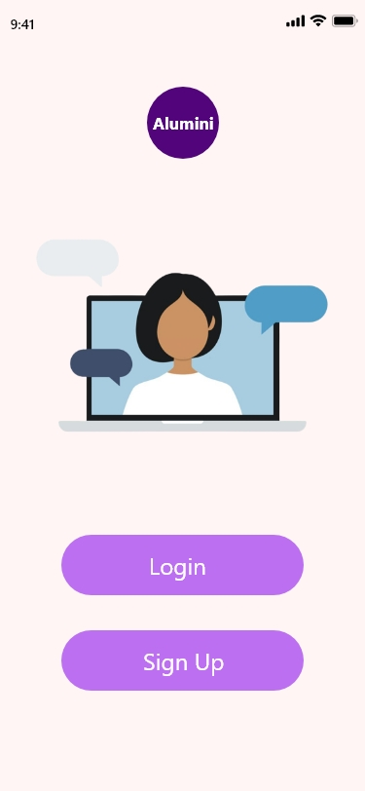
Work done till date

Slide 14
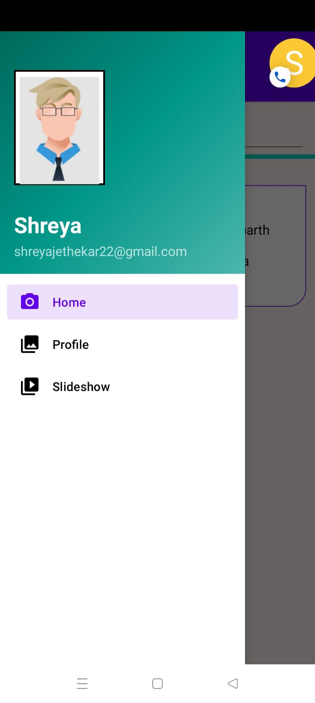
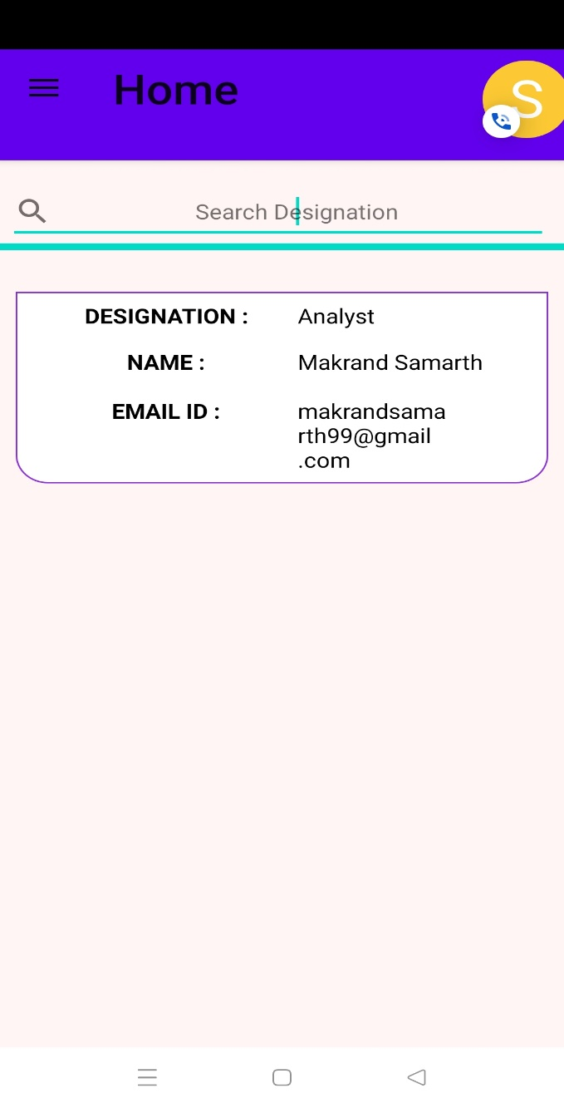
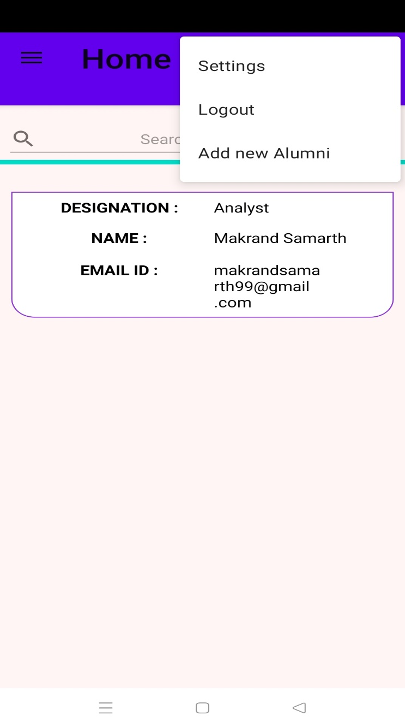
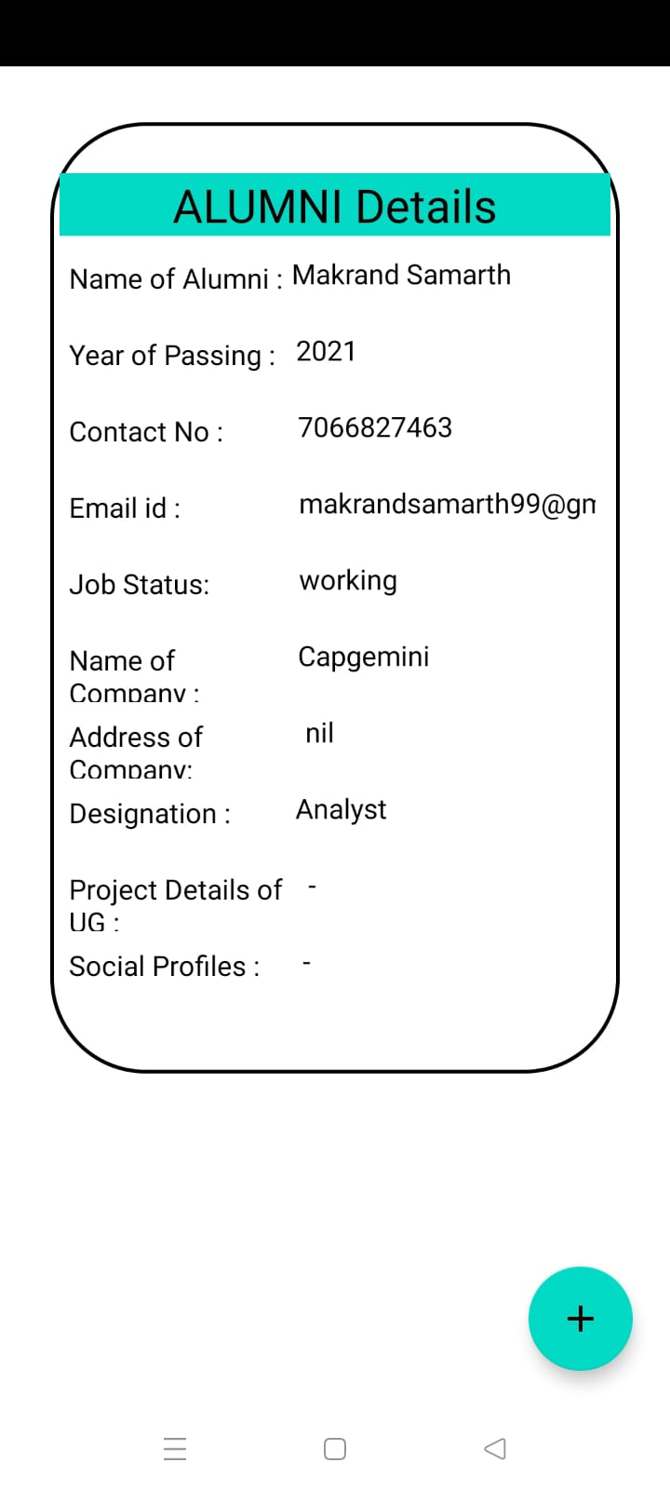
Work done till date

Slide 15
Expected Result
Expected output of the project
Simple registration process for the Alumni.
Interaction of Teachers with Ex-Students will automatically increase the awareness of the teacher’s awareness about the Industry.
A tool to automate an Alumni Culture or Alumni Policy.
system achieves the effective collection of mass alumni data, the optimization of alumni management process and the extension of alumni information collection channels.
The biggest problem of Education in India is that it is far from what Industry demands. A vibrant Alumni System helps reduce that Gap.

Slide 16
References
List of papers/books/websites etc refered for project
CAs Based Student-Alumni Management System
-IEEE
Papers name.
Features of Alumni Management System
01, June 2021
Anand Shirke

Slide 17
Thank you !

